Slide 1
RATE OF INTEREST
PREDICTION USING LGBM

Slide 2
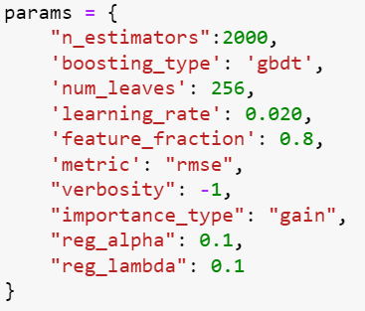
MODEL SUMMARY
Utilized LightGBM, a gradient boosting framework, known for its efficiency and accuracy with large datasets.
Employed K-fold cross-validation for robust evaluation and to ensure generalization.
HANDELING DATA SPARSITY
LightGBM's ability to handle sparse data efficiently was leveraged
Sparse data can be addressed by appropriate parameter tuning and feature engineering to enhance model performance.
MODELLING TECHNIQUE
LightGBM, a gradient boosting framework, was chosen for its scalability, efficiency, and ability to handle large datasets.
It's an ensemble learning technique that builds multiple decision trees iteratively, aiming to minimize the overall error.

Slide 3
PRE-POST PROCESSING STEPS
Many steps such as feature importance rvalue, rmse score, correlation matrix helped me to arrive to following:
I have created my own features too which is mention in the next slides
ID: Not Taken, Not_relevant for training data
ACCOUNT_TYPE: Taken
HIGH_CREDIT_OR_SANCTIONED_AMOUNT: Taken
DATE_OPENED: Indirectly taken, Relevant, extracted feature out of this in the form of date and time
CURRENT_BALANCE: Taken
ACTUAL_PAYMT_AMT: Taken
EMI_AMOUNT: Taken, empty cells filled as (Sanctioned_loan_amount/Repayment_tenure)
REPAYMENT_TENURE: Taken, empty cells filled with number of months between opened date and reported date
LOAN_CLASSIFICATION: Not taken, very low feature dependence
AMOUNT_OVERDUE: Taken, None cell taken as 0
PAYMENT_HISTORY_1: Taken
PAYMENT_HISTORY_2: Not taken, contains many missing cells
OWNERSHIP_TYPE: Taken
COLLATERALVALUE: Taken, None cell taken as 0
TU_SCORE: Taken
PAYMENT_HISTORY_START_DATE: Not taken, Not relevant
PAYMENT_HISTORY_END_DATE: Not taken, Not relevant

Slide 4
DATE_OF_LAST_PAYMENT: taken, Created date time features
Reported_Date: Not taken, doesnt want to exceed features more than 20
DATE_OF_BIRTH: Not taken, Not relevant
OCCUPATION_TYPE: Taken
GENDER: Not Taken very low feature dependence
Now there are are some features that I have made:
Number_of_past_loans: Number of past loan taken from train_all_loan
Average_loan_amount_in_past: Number of past loan amount taken from train_all_loan
Average_Balance: Average balance while past loan taken from train_all_loan
total_month: Total month between last day of payment and date opened
age: Age at the time of date_opened
credit_utilization_ratio: CURRENT_BALANCE/HIGH_CREDIT_OR_SANCTIONED_AMOUNT
assest_utilization_ratio: HIGH_CREDIT_OR_SANCTIONED_AMOUNT/COLLATERALVALUE
Networth: Total balance + collateral value earned per year in life
average_days_past_due: the average number of days past due based on the provided payment history string.
Combined_category: Occupation type and ownership type are combined
Also there was many empty cell in Repayment_Tenure so I have filled those with number of month between opened date and reported date
Also there was many empty cell in Occupation type that is converted into categorical data.
Each series in df is converted into normal distribution except categorical and date_time features.

Slide 5
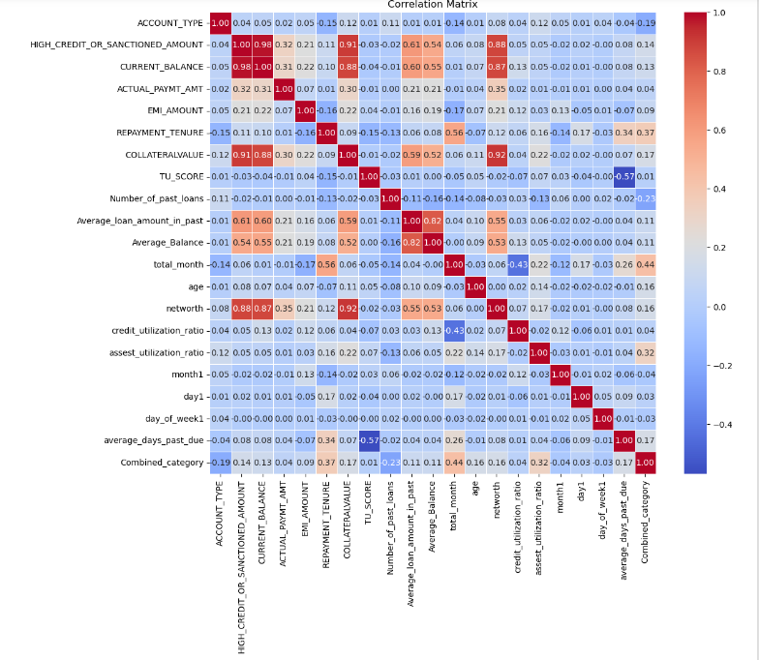

Slide 6
Challenges to Model Deployment, Explainability, and Interpretability:
Model deployment challenges might include ensuring scalability, integration with existing systems, and real-time inference.
Explainability and interpretability can be challenging with complex models like gradient boosting. Techniques like SHAP (SHapley Additive exPlanations) values can provide insights into feature importance.
Ensuring that stakeholders understand and trust the model's predictions is crucial for deployment Potentia.
Model Enhancements in Future:
Incorporating domain knowledge for feature engineering can enhance model performance and interpretability.
Ensemble methods such as stacking or blending different models can further improve predictive performance.
Exploring advanced techniques like neural networks or deep learning architectures might be beneficial, especially for capturing complex patterns in the data.
Continuous monitoring and updating of the model to adapt to changing data distributions and requirements are essential for long-term effectiveness

Slide 7
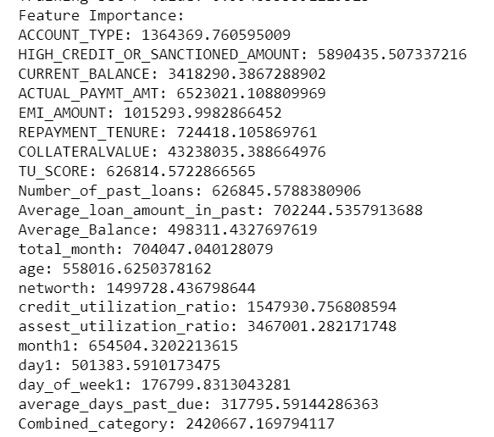
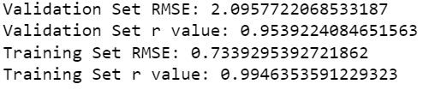
Some other Information
There are some graphs which
can be seen in the the
jupyter notebook

